Slide 1


TASK MANAGEMENT SYSTEM

Slide 2
Aim
To develop a task manager that enables users to efficiently organize and monitor their personal and professional tasks, while also keeping them updated with real-time news highlights.

Slide 3

Introduction Introduction
In modern work environments, managing tasks efficiently is essential for productivity and teamwork. Many teams struggle with unclear assignments, missed deadlines, and poor communication. A Task Management System solves these issues by providing a centralized, user-friendly platform to create, assign, and track tasks, improving collaboration and ensuring timely completion.

Slide 4
Programming language Used
Frontend : html, css, JavaScript, jQuery .
Backend : News API

Slide 5
Features
Login/Register : Demo login using jQuery & LocalStorage.
Task Timer : Set time for each task.
Edit/Delete/Complete : Easily manage tasks.
Task Categories : Separate personal & professional pages.
Mood Suggestions : Get task or break tips based on mood.
Google Calendar : Easily access and manage events within the task manager.
News Widget : Live headlines via API.

Slide 6
Applications
Personal Tasks : Organize and complete daily goals.
Student Use : Track assignments and study plans.
Mood-Based Boost : Mood input suggests tasks or breaks.
Time Management : Set timers to stay on schedule.
Live Updates : News widget for real-time info.
Project Showcase : Frontend mini-project using HTML, CSS, jQuery.

Slide 7
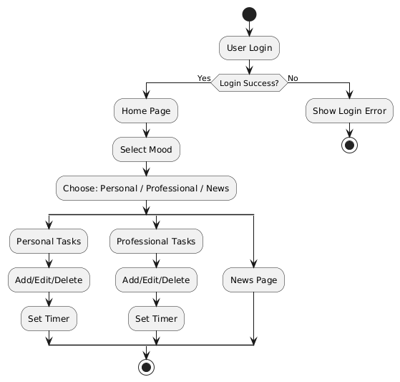
Project Architecture

Slide 8
Future Scope
Task Prioritization with AI : Automatically assign priority levels to tasks based on deadlines and importance.
Cross-Platform App : Develop Android/iOS and desktop versions for better accessibility.
Recurring Tasks Support : Allow users to set daily/weekly/monthly recurring tasks.
Custom Notifications Settings : Let users set when and how they want to be notified for different tasks.
Custom Widgets : Allow users to add productivity timers, quotes, or quick notes to the home page.

Slide 9
Conclusion
The Task Management System helps users manage tasks efficiently with simple features like mood check, timers, and news access. It boosts productivity and is easy to use.

Slide 10
Group Members
Guide Name : Jyostna A. Nanajkar
Branch : Information Technology.
Class and Division : SE - A
Student roll no. and Name :
1 . Khushi Chavan (S551015)
2 . Payal Dhumal (S511026)
3 . Shweta Ithape (S511047)
4 . Anuja Kendre (S511061)

Slide 11
THANK YOU !

